Slide 1
EDUCATION RESOURCE PLATFORM

Slide 2
Problem statement
The purpose of the project is to help students to manage their activities through a single platform.
It will also help teaching assistants and research assistants to manage and log their activities through this platform.
The professor can easily release and review assignments, grade students, track TA`s and RA`s activities and view statistical reports such as TA`s and RA`s weekly hours, average student grades etc.

Slide 3
Introduction
Education resource platform is an application to manage all the academic functionalities of the university.
Academic functionalities like uploading assignments, grading of the assignments by TA’s, final grading by the professor, discussion feeds, addition of courses by program coordinator etc.

Slide 4
ROLES
1. Professor.
2. Teaching Assistant.
3. Research Assistant.
4. Student.
5. Program Director.
6. Program Coordinator.
7. Admin.

Slide 5
Administrator Types
1. Admin – managing countries and universities.
2. University Admin – managing colleges and students.
3. College Admin – managing majors, program director, program coordinator and professors.

Slide 6
Task List
1. Professor:
Release Assignments.
Final Grading.
Assign TA’s and RA’s.
Teaching Assistant:
Assignment reviews.
Knowledge hours.

Slide 7
Task List
3. Research Assistant:
Working hours.
Reports.
4. Program Director:
Manage requests submitted by Program Coordinator.
5. Program Coordinator:
Manage Courses.
Assign Professors.

Slide 8
Special Functionalities
Feed Page.
Discussion thread on assignments.
Live TA\RA hours tracking.
Clocked TA\RA working hours.
Clocked assignment reviews.
Interactive Dashboards.
Assignment Upload feature.

Slide 9
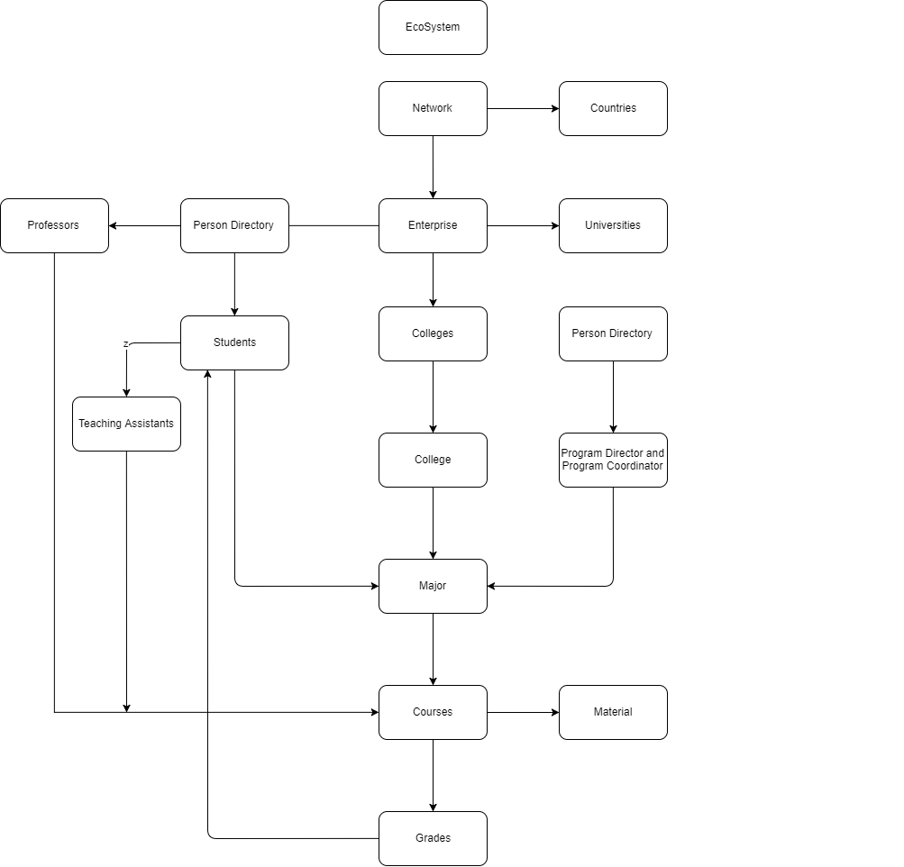
Object Model

Slide 10
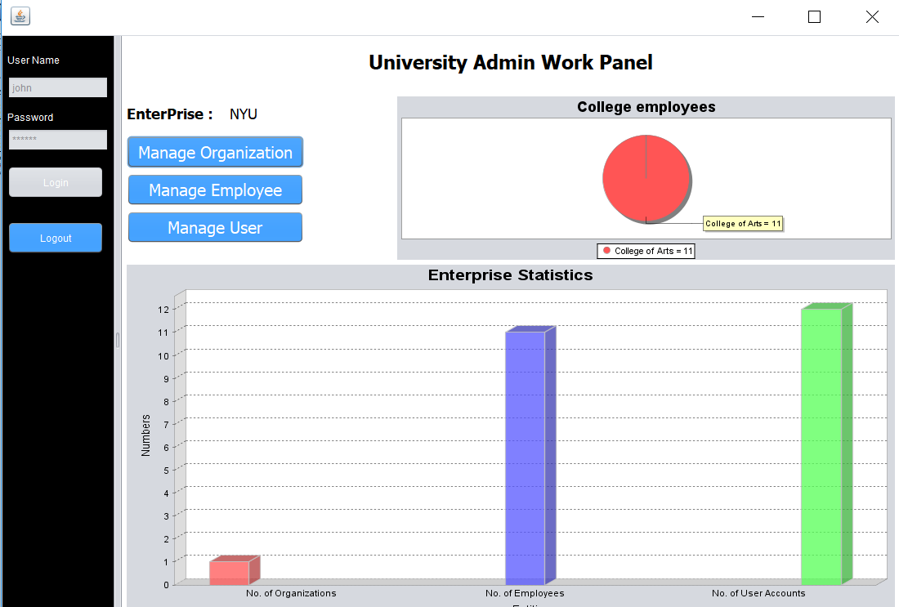
Dashboard Showing all the statistics for University Admin

Slide 11
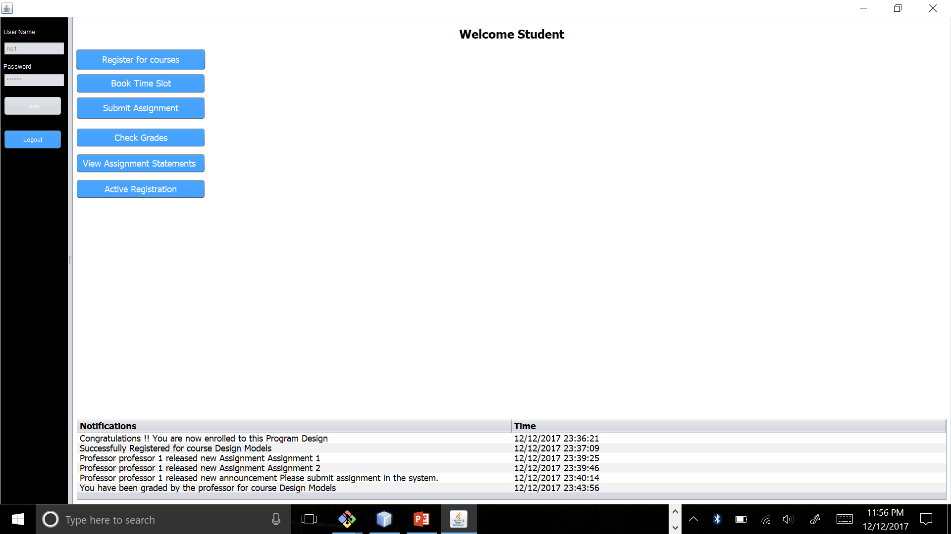
Student Work Area panel showing Live Feeds

Slide 12
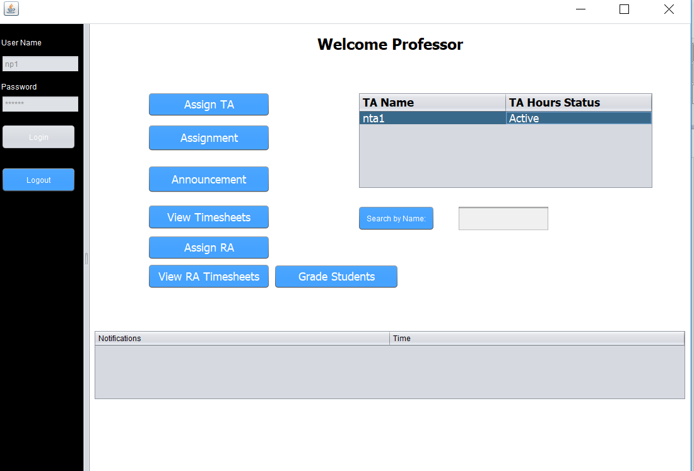
Professor Work area Panel

Slide 13
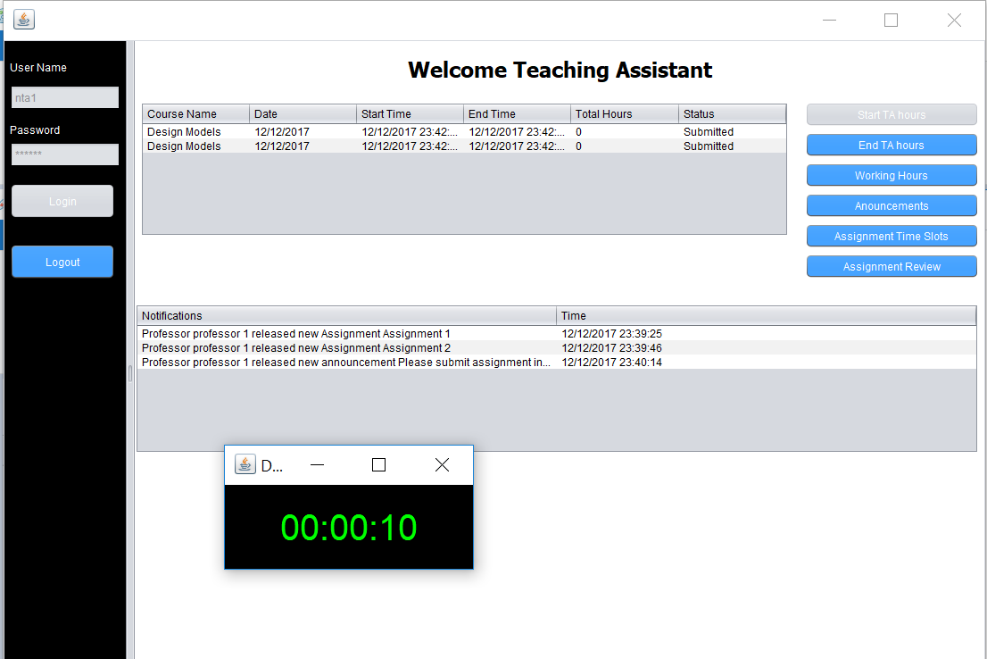
Teaching Assistant Work area panel

Slide 14
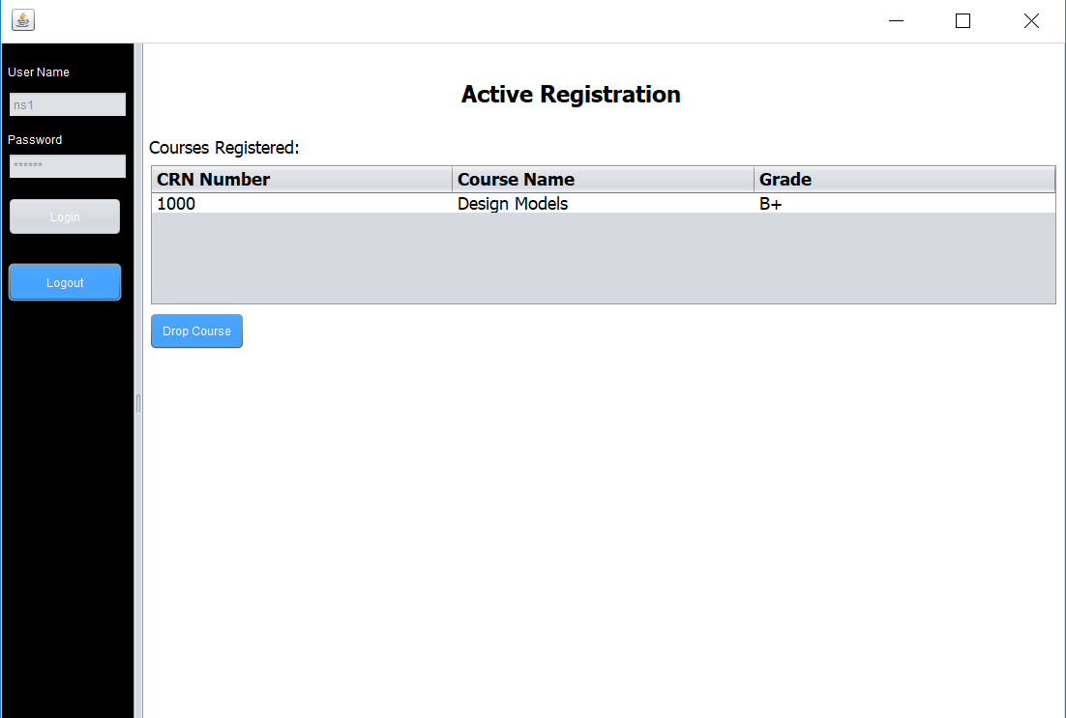
Active Registration with Grade of each Course for Students

Slide 15
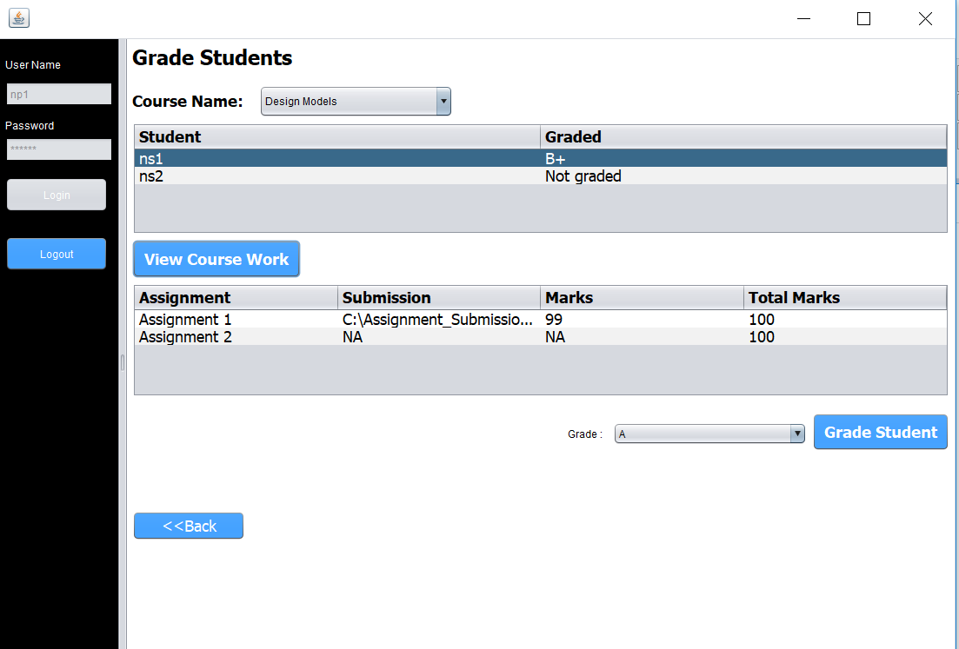
Assignment Submission and Grading for Students

Slide 16
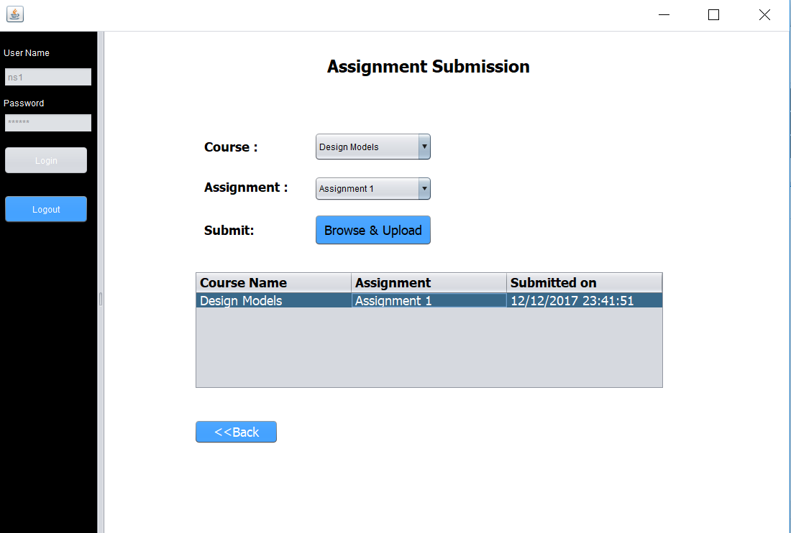
Assignment Submission Panel

Slide 17
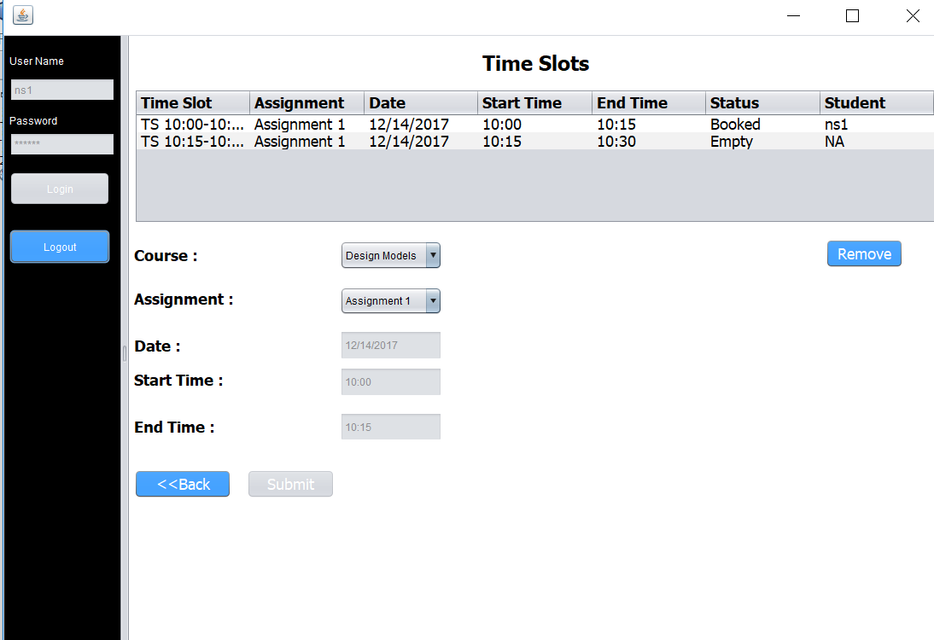
Time Slots for Code Review

Slide 18
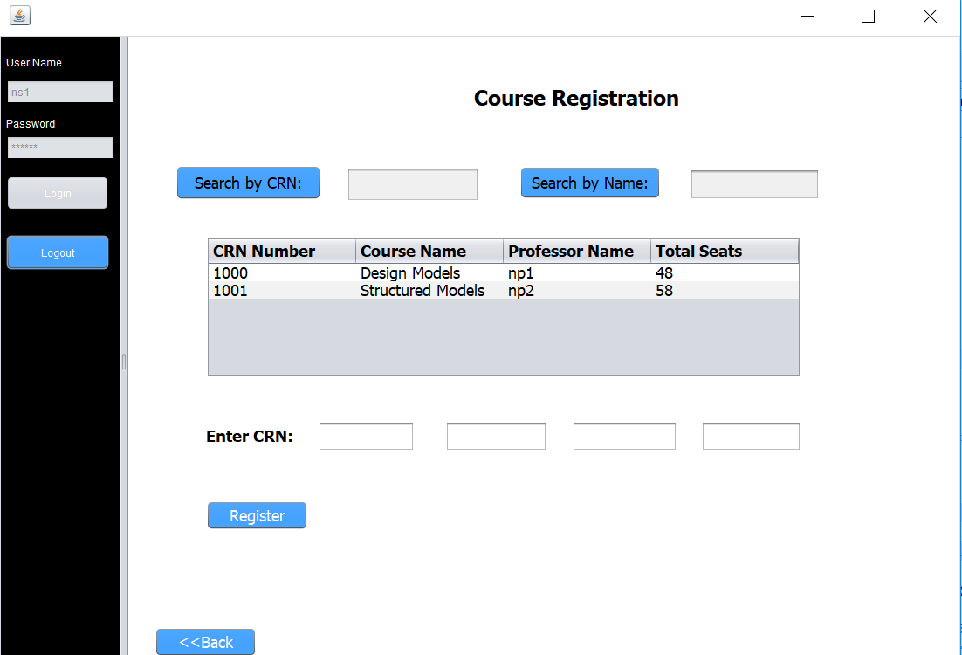
Course Registration for Students

Slide 19
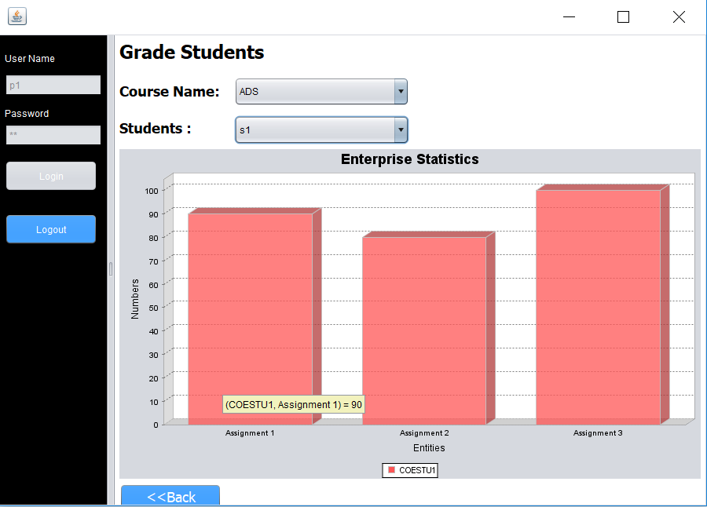
Graph for grades of students

Slide 20
Thank you!

